Slide 1

Purpose:
The aim of this guide is to provide leadership training for ASTRA officers
and committee chairs so that you may become more effective in your leadership roles and further develop helpful knowledge and skills.
The skills you gain in communication, building relationships, conflict management, time management, and project management will enable you to become stronger leaders in your current role, in your school, and in future leadership roles in your community.
ASTRA
LEADERSHIP
TRAINING

Slide 2

You have been elected by your peers, which means they believe that your club’s future looks great when placed in your capable hands!
They believe you can inspire and lead them as your club grows in
service to your community and beyond!
Leadership is about one life influencing another.
It’s about empowering those we lead.

Slide 3
What is leadership?
Leadership involves a set of skills including the ability
to inspire and motivate others,
to communicate effectively,
to take initiative,
to develop effective partnerships,
to make plans and execute them,
to blend individual gifts and styles of members to strengthen the organization and its service.
Which of these seems most challenging for you?
That’s your growing edge, right?

Slide 4
THE GOALS OF
ASTRA ARE:
to provide opportunities for personal development, career planning and preparation, leadership training, and citizenship development;
to foster the concept of service through practical application in school and our community;
to sponsor social and cultural activities;
to promote fellowship and better understanding among all people.
ASTRA Club of Atlee HS
Mechanicsville, VA
District Two

Slide 5
Partnering with your sponsoring
Altrusa Club
has many benefits.
This partnership provides opportunities to:
Share ideas and options for practicing leadership and providing service.
Encourage you as ASTRA members in developing your leadership skills.
Provide mentoring with Altrusans that builds long-lasting relationships.
Learn about goal setting, conflict resolution, team building, and communication from experienced Altrusans as challenges are faced in leadership.

Slide 6
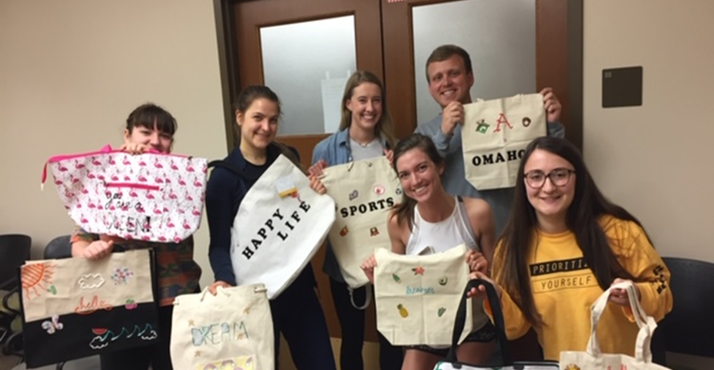
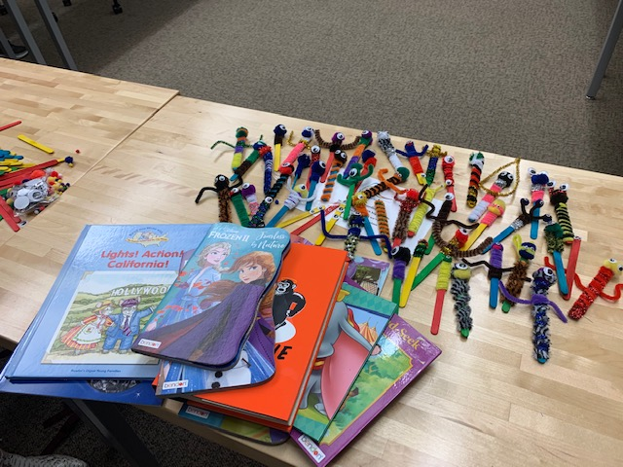
It’s exciting to
Partner in Service!
They made bookmarks to go with donated
new books into a library Altrusa had built
for a community center. They then helped
Altrusans make bookmarks for their other
literacy projects!
ASTRA at the U. of A. partnered with Altrusa to
provide fun bags for children moving into foster care.

Slide 7
Let’s lay a foundation for your leadership.
What are some characteristics of a successful leader? Please take a look at these and discuss them with each other. Which are most important to you?
A willingness to learn: Leadership skills are learned; everyone can become a leader!
A desire to recognize and encourage greatness in others: Every person has talents, gifts and experiences to bring. As a leader you can help develop them. Effective leaders encourage and grow leaders! Ralph Waldo Emerson wrote, “Our chief want is someone who will inspire us to be what we know we could be.”
A willingness to risk and to change: Realizing that change starts with each of us we can all be change agents if we have the courage to risk change to be more effective.
An ability to listen receptively and to be flexible: Learning to be flexible depending on the situation and those you are leading helps you more effectively provide leadership and the organization succeed.

Slide 8
So, here are some more characteristics
of a successful leader!
An eagerness to nurture the ability of your members and officers to dream great dreams and to be stewards of the organization.
The willingness to build a team: Learning to delegate, to build collaboration and communication among your members, to ask for help as needed and to show gratitude for efforts made nurtures everyone you lead.
The ability to build community within your organization: Uniting those who are working together in ASTRA to serve each other and your community will make your service together powerful and fun.
The ability to model commitment and responsibility: Your members will reflect your enthusiasm, commitment and sense of responsibility to ASTRA as you work together.
The confidence to be your own authentic self: John Ruskin wrote, “The highest reward for a person’s toil is not what they get for it, but what they become by it.” As you are authentic and willing to learn, your members will grow in their respect and enthusiasm for what you can all accomplish together.

Slide 9
Now to some specifics you
may have on your mind:
Where can I go to understand my specific role and responsibility
as I assume leadership?
President
Vice President
Treasurer
Secretary
Committee Chair
https://astra.altrusa.org/files/2021/02/ASTRA-Committee-Chair-Responsibilities.pdf AND https://astra.altrusa.org/files/2021/02/ASTRA-Club-Leadership-Manual-2020.pdf

Slide 10

You may want to keep these resources handy as your club makes decisions:
1. Club Leadership Manual
2. ASTRA Monthly Checklist https://astra.altrusa.org/files/2021/02/ASTRA-Monthly-Checklist-2020.pdf
3. ASTRA Members Guide https://astra.altrusa.org/files/2019/10/ASTRA-Members-Guide-February-2018-update.pdf
AVAILABLE ON INTERNATIONAL WEBSITE
https://astra.altrusa.org/files/2021/02/ASTRA-Club-Leadership-Manual-2020.pdf

Slide 11
A transition/mentoring session will be very helpful!
Here are some ideas on how that might happen:
Have the previous officer sit with the incoming officer and have a one-on-one session. Discuss what worked for them as an officer in their position and what did not work. Have the outgoing officer explain in their own words the details of the position.
Have a very brief outline of each officer’s duties on paper to provide to the incoming officers so they can reference, take notes, or ask questions.
Have an officer from the parent Altrusa Club have a one-on-one session with the incoming ASTRA officer of the same position. The Altrusa member can mentor the ASTRA leader and explain how they perform their duties in the Altrusa Club
At the end of the year have a final meeting among the outgoing officers and the ASTRA Sponsor/Chair to discuss any difficulties/big wins each officer had during their time. Discuss how to improve each position's duties to better support the club. Collectively create words of wisdom to pass on to the next officers.

Slide 12
How do I lead an effective ASTRA meeting?
It helps ensure effective meetings if you:
Provide structure through a thoughtfully assembled agenda. A sample is available at https://astra.altrusa.org/
Allow plenty of time for discussions that honor input from multiple people. Officers
should not do all the talking. The more the whole group is involved, the more confidence
they’ll have in the decisions made by the group.
Facilitate a discussion that leads to clarity about the will of the group and voting if needed. Working toward consensus about “What shall we do?” and “How shall we go about it?” is vital.
Applying Roberts Rules of Order can help facilitate decision making that is efficient and respectful. https://astra.altrusa.org/files/2020/11/ASTRA-Roberts-Rules-of-Order-Chart-10-19-20.pdf
Provide clear communication about upcoming service/event dates.

Slide 13

AGENDA PREPARATION
DEVELOP YOUR AGENDA AROUND THESE:
Minutes from previous meeting
Reports of Officers
Reports of Committees
Correspondence
Program
Unfinished Business
New Business
Sharing Time

Slide 14
How do we grow our ASTRA Club
and recruit new members?
Expand your circle of who you talk with about ASTRA.
Publicize in effective ways that anyone can be an ASTRA member. Make it clear that membership is not about grades, popularity, or prior leadership experiences. ASTRA is about service and leadership.
Have a fun activity early in school year to recruit members. How about a pizza party, pumpkin carving?
Share successful service throughout the year in ways that might involve and encourage more new members.

Slide 15
MORE IDEAS ON HOW TO RECRUIT
ASTRA MEMBERS FOR YOUR CLUB:
Brainstorm about local youth known to Altrusans already, and have Altrusans help recruit new ASTRA members
Send out flyers and have announcements made at the school; send out letters of invitation to come to the first ASTRA meeting
Have ASTRA Club information put into any student bulletins or information given out by the school regarding its clubs
Have an informational ASTRA booth at a Club Fair at the school
Contact school staff who know about students interested in leadership and service opportunities
Schedule service activities and invite any students to join in and then sign them up for ASTRA after the event
Use social media—Facebook, Instagram, Twitter, etc.
Use word of mouth by students and parents!
ASTRA Club of Moberly, MO District Eight
ASTRA Club of
Patria Latorre HS
San Sebastian, PR
District Fourteen

Slide 16
What is key to excellent service and
program planning and evaluation?
Identify school and community needs and your members’ interests. Think broadly here as you volunteer in your school, local community, other communities on a national or international level.
Plan a hands-on project to work on together at every ASTRA meeting.
As you plan a project or event, be sure to consider and problem-solve:
    Logistics
    Roadblocks
    Schedule
    Resources needed and available
    Budget
    Volunteers’ enthusiasm and commitment of time
Stuff happens: Work together to learn from the situation, mistakes, unforeseen challenges. As a famous coach admonished: There are only 3 things to do with a mistake:
Acknowledge it, learn from it, and don’t repeat it. Evaluate service projects, fund-raisers,
membership recruitment honestly as you plan for the next event or year.

Slide 17
You migHt consider collaboration between ASTRA Clubs
ASTRA Club of
Pendleton,Oregon
District Twleve
Ideas include:
A joint project that spans all ASTRA Clubs in a shared project within your Altrusa district
ASTRA members from each district often participate in their district conference, building rapport
Utilize the Service Project List to share project ideas with other clubs
See more ideas at:
https://astra.altrusa.org/files/2019/04/ASTRA-Service-Projects-List-2018-D2.pdf
ASTRA Club of Notre Dame Academy,
Green Bay, WI
District Seven
ASTRA Club of the
University of Arkansas
Fayetteville, AR
District Eight

Slide 18

SET YOUR GOALS and then take action.
Those who set goals for themselves are more likely to achieve success!

Slide 19
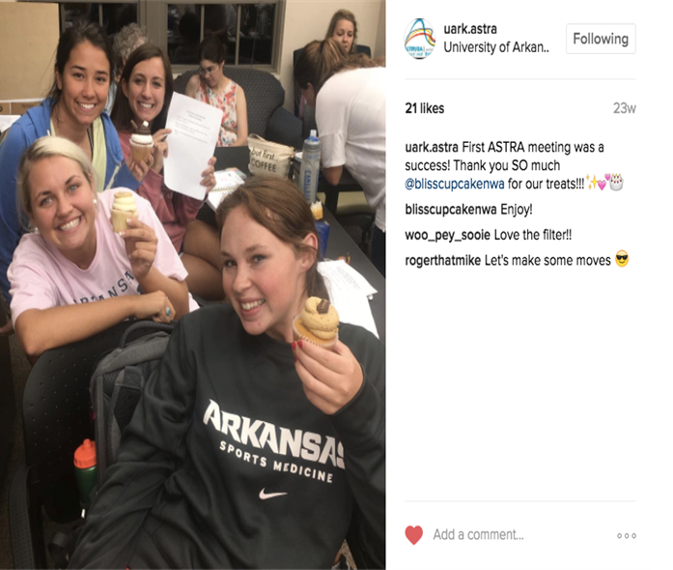



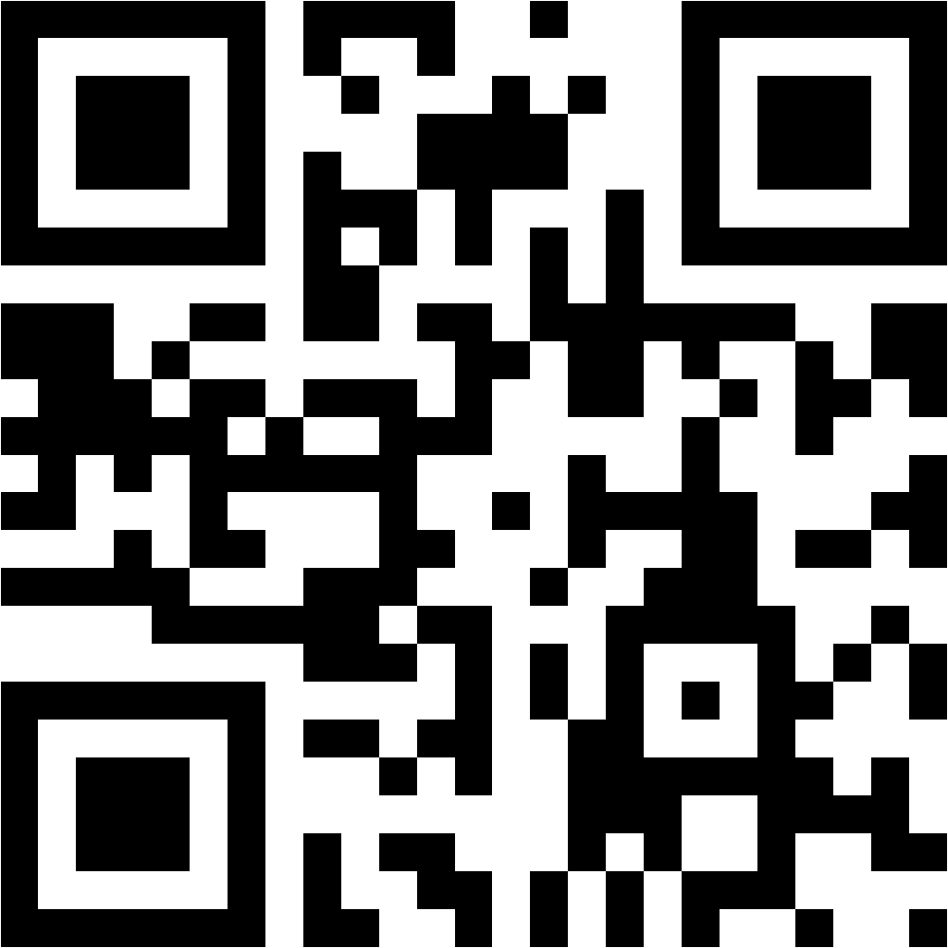

Enhance Communication
USING the website and social media
Spread info with apps, club Facebook page, social media, bulletin boards, in school daily messages, written notes, school newspaper, invite the media to ASTRA event.
Publicize the AMAZING service your members provide!
SHARE your LOVE of SERVICE!! Invite others to join in service!
ASTRA Club of Austin TX
District Nine
ASTRA Club of the
University of Arkansas
District Eight

Slide 20
FUNDRAISING helps make
exciting projects happen!
Create a meaningful reason to raise funds. What is a realistic fundraising goal and timeline and what will the money be used for? Who will buy what the ASTRA members are selling?
Have the ASTRA members set goals and plan the details of their fundraising campaign (including venues, supplies, tickets, food, advertising, volunteers).
Assign responsibilities to the Fundraising Committee members, work with the Publicity Committee to advertise the event well through social media and other means.
Consider collaborating with a local organization to match funds (including Altrusa), and try to connect the ASTRA members with the people whom they are going to be helping with the funds.
There are three broad categories of fundraisers: seasonal event fundraisers (Halloween, Christmas, Valentines, Graduation, etc.), item fundraisers (selling food, merchandise, pins, etc.), and project fundraisers (providing aservice to raise money, such as car washes, carnival booths, dances, etc.) There many more ideas on the ASTRA website.

Slide 21
Where can I get more help?
I know I’ll have more questions later!
There are lots of online ASTRA resources and other leadership resources available for you:
Your Altrusa International ASTRA website https://astra.altrusa.org/
Your ASTRA Advisors/Sponsors can guide you to:
Leadership books and websites
Articles on communication and team building within organizations
Articles on conflict resolution
Articles on time-management

